Slide 1


Unit 4
Organizing the review and interpretation process
Notes:
Welcome to Unit 4, Organizing the review and interpretation process.

Slide 2
By the end of this unit, you will:
describe the organization of a country HHFA data review and interpretation process
Notes:
By the end of this unit, you will:
describe the organization of a country HHFA data review and interpretation process.

Slide 3



Organizing HHFA data review and interpretation processes
core HHFA data analysis team
leads processes and meetings
HHFA report
Notes:
A key step in the organization of the data review and interpretation processes, is the establishment of a core HHFA data analysis team.
This team leads the various processes and meetings required for data review and interpretation, and guides the production of the final HHFA report.

Slide 4

Organizing HHFA data review and interpretation processes
HHFA core data analysis team:
data analysts
monitoring and evaluation experts
health systems experts
Notes:
The HHFA core data analysis team usually consists of a small group of:
data analysts;
monitoring and evaluation experts; and
health systems experts.

Slide 5
Organizing HHFA data review and interpretation processes
staff of the ministry of health
partners
academic institutions
consultants
“insiders” and “outsiders”
Notes:
The core data analysis team should always include staff of the ministry of health, and may also include:
partners;
academic institutions; and
consultants.
The team should ideally include both “insiders” and “outsiders”.

Slide 6
Organizing HHFA data review and interpretation processes
Insiders
Outsiders
deep understanding of the country / health system
bring new perspectives
provide a more objective/critical interpretation of findings
nationals or long-term residents
may be too close to topic
highlight useful experiences from other countries
could hinder objectivity
Notes:
Insiders are individuals who have a deep understanding of the country and its health system. They are usually nationals or long-term residents of the country.
However, there is a risk that sometimes insider experts may be too close to the topics under review, and this could hinder their objectivity.
Often, the addition of “outsider” experts, such as international consultants, to the team can:
bring new perspectives;
provide a more objective and critical interpretation of sensitive findings; and
highlight useful experiences from other countries.

Slide 7

Organizing HHFA data review and interpretation processes
HHFA data review and interpretation usually involve:
a comprehensive initial review and description of the standard analysis platform outputs
in-depth reviews of programme-specific data by relevant experts
an interpretation or report-writing workshop
Next: we will look at each of these three components.
Notes:
HHFA data review and interpretation usually involve the following components:
a comprehensive initial review and description of the standard analysis platform outputs;
in-depth reviews of programme-specific data by relevant experts; and
an interpretation or report-writing workshop.
Next, we will look at what each of these three components consists of, why it is important, who is involved, and how it is done.

Slide 8
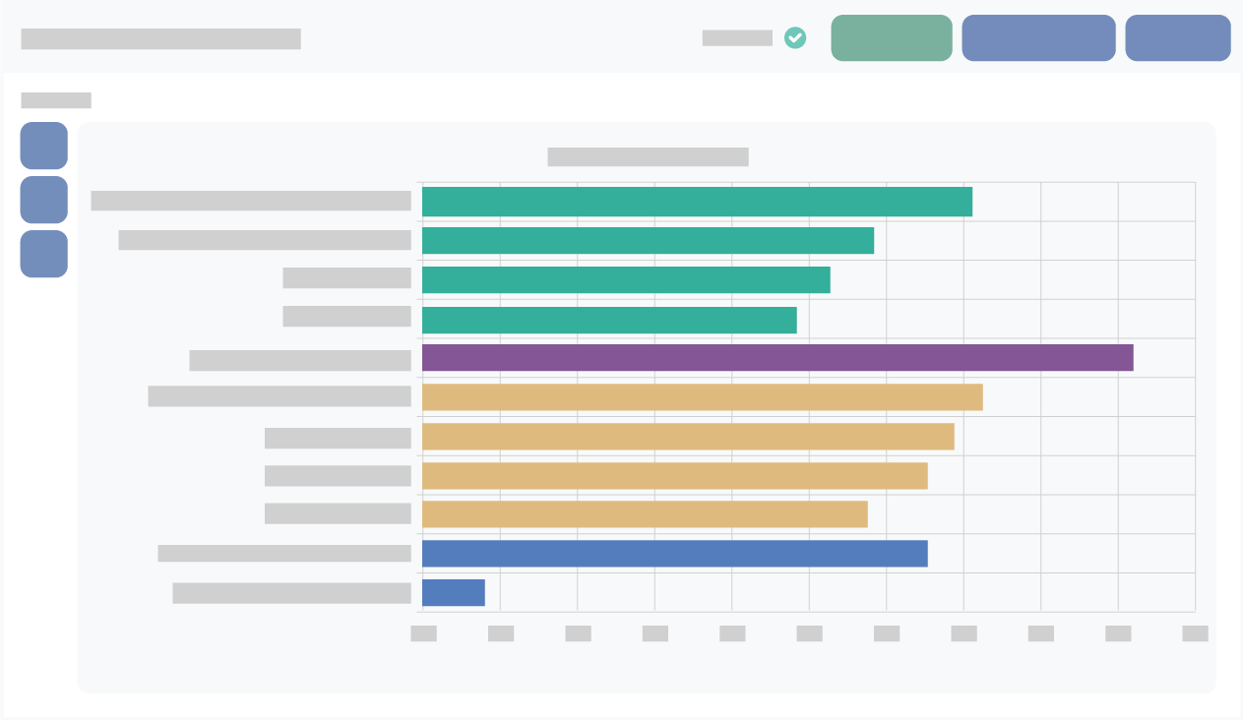
1. Comprehensive initial data review and description
What
Who
review of all standard tables and graphs
conducted by core data analysis team
Notes:
The initial data review and description process involves a comprehensive review of ALL the standard tables and graphs produced by the analysis platform.
This initial review is conducted by the core data analysis team.

Slide 9
1. Comprehensive initial data review and description
Why
obtain a preliminary overview of the major findings across the survey
avoid overlooking any important findings
identify data quality issues
identify issues that should be highlighted to programme/management experts
identify significant common factors or differences among programmes
Notes:
It is important that the scope of this initial review is comprehensive, in order to:
obtain a preliminary overview of the major findings across the survey;
avoid overlooking any important findings;
identify any data quality issues that were not found during data cleaning in CSPro;
identify issues that should be highlighted to specific programme or management experts in the next phase of the review; and
identify any significant common factors or differences in the service availability or readiness of different programmes.

Slide 10
1. Comprehensive initial data review and description
Module 3
HHFA data review and description
How the data review and description is conducted is discussed in Module 3.
Notes:
The process for conducting the comprehensive initial data review and description is discussed in detail in Module 3.

Slide 11
2. In-depth reviews by programme-specific experts
What
Who
Why
In-depth reviews of specific sections of the analysis outputs
Experts in the specific programme or technical area
Subject matter experts bring:
detailed knowledge of the programme
Examples
Malaria section
understanding of specific contextual issues
HIV section
Surgical services section
Notes:
Following the initial comprehensive review, in-depth reviews of specific sections of the analysis outputs are conducted by groups of experts in the relevant programme or technical area.
For example, the in-depth reviews may look at the Malaria section, the HIV section, or the surgical services section.
These in-depth reviews are important, as subject matter experts bring detailed knowledge of the programme and an understanding of contextual issues specifically relevant to the programme.

Slide 12

2. In-depth reviews by programme-specific experts
How
Core data analysis team supports experts by:
explaining the overall survey findings
preparing the specific analysis platform outputs for each expert group
highlighting potential concerns
engaging experts in discussions to refine analysis/develop recommendations
This process may require several rounds of discussion, further exploration of the data, and review of information from various sources to help explain the findings.
Notes:
The core data analysis team supports the programme experts by:
explaining the overall survey findings, to provide a context for the programme-specific reviews;
preparing the specific analysis platform outputs for each expert group;
highlighting potential concerns in the programme findings that were identified during the initial review; and
engaging the experts in discussions to refine the analysis and interpretation, and to develop recommendations.
This process may require several rounds of discussion, further exploration of the data, and review of information from various sources to help explain the findings.

Slide 13
3. Interpretation workshop
What
An interpretation or report writing workshop is convened for final review of the HHFA findings and interpretations
Who
The core data analysis team, representatives of various technical programmes, the survey coordination group, and other key technical stakeholders
Why
Development of final conclusions, priorities and recommendations, that serve as the basis for the final HHFA report
Notes:
After the programme-specific reviews, an interpretation or report-writing workshop can be convened for final review of the HHFA findings and interpretations.
The workshop brings together the:
core data analysis team;
representatives of various technical programmes;
the survey coordination group; and
other key technical stakeholders.
The participants provide further interpretation if needed, and develop final conclusions, priorities and recommendations.
The outputs of this workshop will form the basis of the final HHFA report.

Slide 14
3. Interpretation workshop
How
summarizing key findings
careful selection of participants
organization of participants into groups
structured process for what each group will review/produce
guidance on reaching conclusions, identifying priorities, developing recommendations
Notes:
The interpretation workshop is led by the core data analysis team.
The workshop requires thorough preparation, including:
summarizing the key findings, including any controversial or unexpected findings;
careful selection of participants;
organization of participants into groups;
a structured process for what each group will review and what they should produce; and
guidance on the process of reaching conclusions, identifying priorities, and developing key recommendations that will support decision-making.

Slide 15
You have now completed Unit 4.
Now try the end-of-module quiz.
Notes:
You have now completed Unit 4.
Now try the end-of-module quiz.

